Slide 1
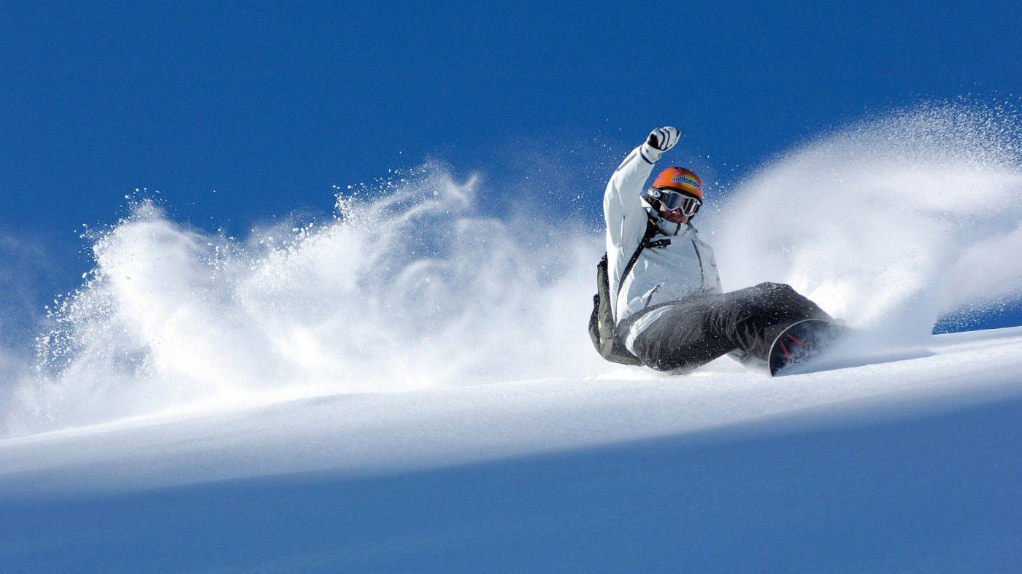
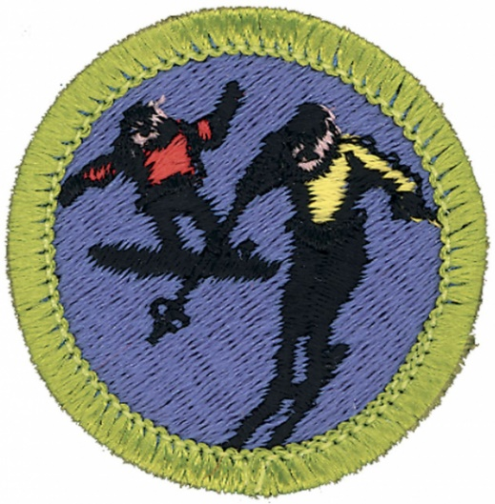
Snowboarding Option
Troop 344 and 9344
Pemberville, OH
Snow Sports Merit Badge

Slide 2
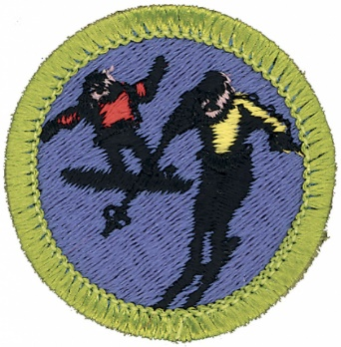
Snow Sports
Do the following:
  Explain to your counselor the hazards you are most likely to encounter while participating in snow sport activities, and what you should do to anticipate, help prevent, mitigate, and respond to these hazards.
  Discuss first aid and prevention for the types of injuries or illnesses that could occur while participating in snow sports, including hypothermia, frostbite, shock, dehydration, sunburn, concussion, fractures, bruises, sprains, and strains. Tell how to apply splints.
Do the following:
  Explain why every snow sport participant should be prepared to render first aid in the event of an accident.
  Explain the procedure used to report an accident to the local ski patrol or local emergency personnel.
Explain the international trail-marking system.
Discuss the importance of strength, endurance, and flexibility in snow sports. Demonstrate exercises and activities you can do to get fit for the option you choose in requirement 7.
Present yourself properly clothed and equipped for the option you choose in requirement 7. Discuss how the clothing you have chosen will help keep you warm and protected.

Slide 3
Snow Sports
Do EACH of the following:
  Tell the meaning of the Your Responsibility Code for skiers, snow-boarders, and snowshoers. Explain why each rider must follow this code.
  Explain the Smart Style safety program. Tell why it is important and how it applies to participants at snow sport venues in terrain parks and pipes.
  Explain the precautions pertaining to avalanche safety, including the responsibility of individuals regarding avalanche safety.
Complete ALL of the requirements for ONE of the following options: downhill (Alpine) skiing OR cross-country (Nordic) OR snowboarding** OR snowshoeing.
**This presentation addresses the snowboarding requirements.

Slide 4
Snow Sports
Complete all of the requirements for Snowboarding
  Discuss forward-fall injuries.
  Show your ability to select the correct equipment for snowboarding and to use it for safety and comfort.
  Show how to use and maintain your own bindings, and explain the use of the different binding methods. Explain the need for leashes.
  Discuss the four types of snowboards. Demonstrate how to carry a snowboard easily and safely.
  Demonstrate how to ride one kind of lift and explain how to ride two others.
  Demonstrate the basic principles of waxing a snowboard.
  Do the following:
    On a gentle slope, demonstrate beginning snowboarding maneuvers. Show basic ways to control speed and direction. Include the side slipping maneuver.
    On slightly steeper terrain, show traversing.
  On a moderate slope, demonstrate an ollie, a nose-end grab, and a wheelie.
  Make a controlled run down an intermediate slope.
  Demonstrate your ability to ride in varied conditions, including changes in pitch, snow conditions, and moguls. Maintain your balance and ability to turn.
  Name the major snowboarding organizations in the United States and explain their functions.

Slide 5
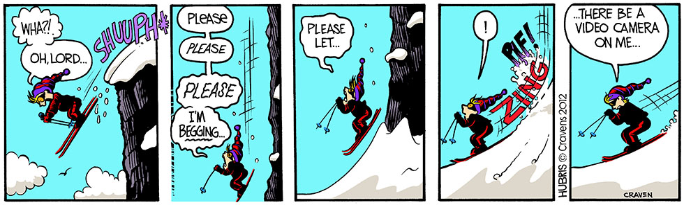
Requirement 1
Do the following:
  Explain to your counselor the hazards you are most likely to encounter while participating in snow sport activities, and what you should do to anticipate, help prevent, mitigate, and respond to these hazards.
  Discuss first aid and prevention for the types of injuries or illnesses that could occur while participating in snow sports, including hypothermia, frostbite, shock, dehydration, sunburn, concussion, fractures, bruises, sprains, and strains. Tell how to apply splints.

Slide 6
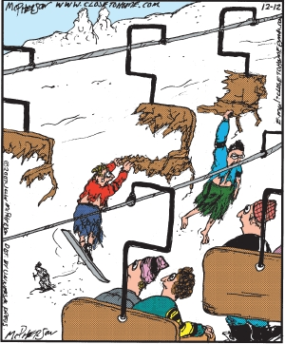
Winter Sports Safety
Be sure your winter outdoor activities always follow these guidelines:
All winter activities must be supervised by mature and conscientious adults (at least one of whom must be age 21 or older) who understand and knowingly accept responsibility for the well-being and safety of the youth in their care.
Winter sports activities embody intrinsic hazards that vary from sport to sport. Participants should be aware of the potential hazards of any winter sport before engaging in it.
Appropriate personal protective equipment is required for all activities. The use of helmets is required for the following activities: downhill skiing, snowboarding and operating snowmobiles (requires full face helmets).

Slide 7
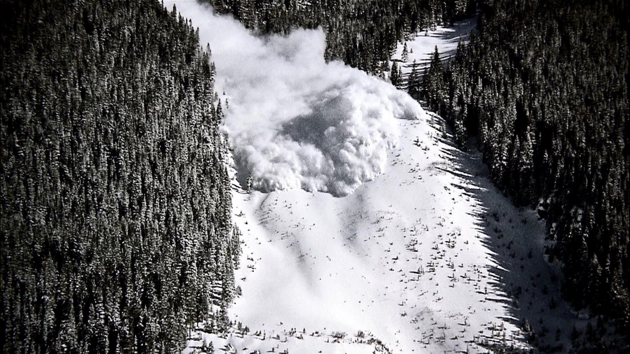
Snow Sport Hazards - Avalanches
Scouts should be aware of the signs of avalanche-prone areas, such as steep slopes and recent snowfall.
They should avoid these areas or travel with proper avalanche safety equipment, including a beacon, shovel, and probe.
Scouts should also learn how to recognize unstable snow conditions and make informed decisions about where and when to ski or snowboard.

Slide 8
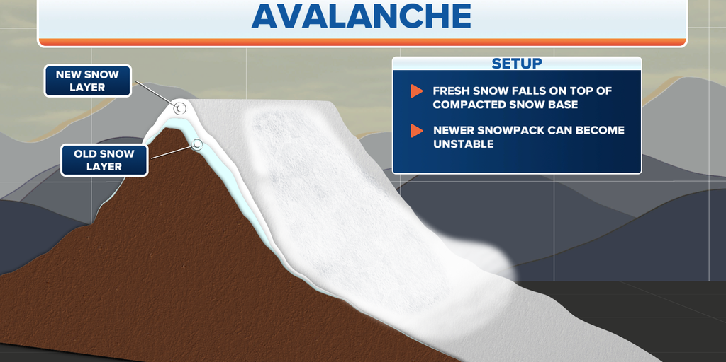
Causes of Avalanches
An avalanche occurs when a layer of snow looses its grip on a slope and slides downhill.

Slide 9
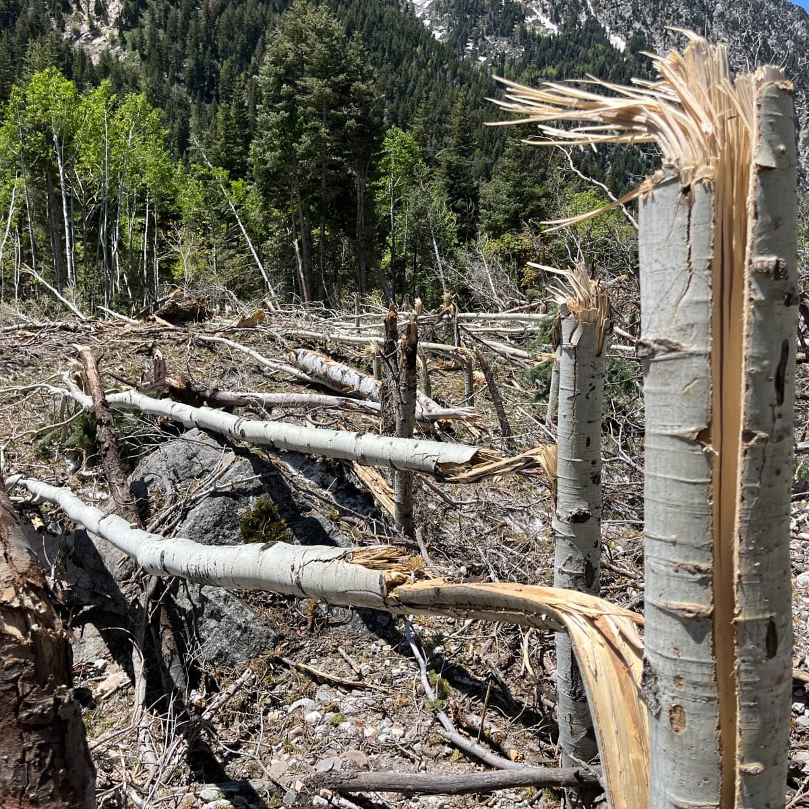
Be Aware of Avalanche Conditions
Most avalanches occur during or just after snowstorms on slopes between 30 and 45 degrees.
A significant snowfall may result in an unstable snowpack.
By waiting at least 36 hours after a big snow or wind storm before you go into the mountains will allow for the snow to become more stable and less likely to avalanche.
Avalanche warnings and special advisories are included on NWS websites and broadcast over NOAA Weather Radio.
Refer to your local avalanche center for current snowpack conditions!
Avalanche damage

Slide 10
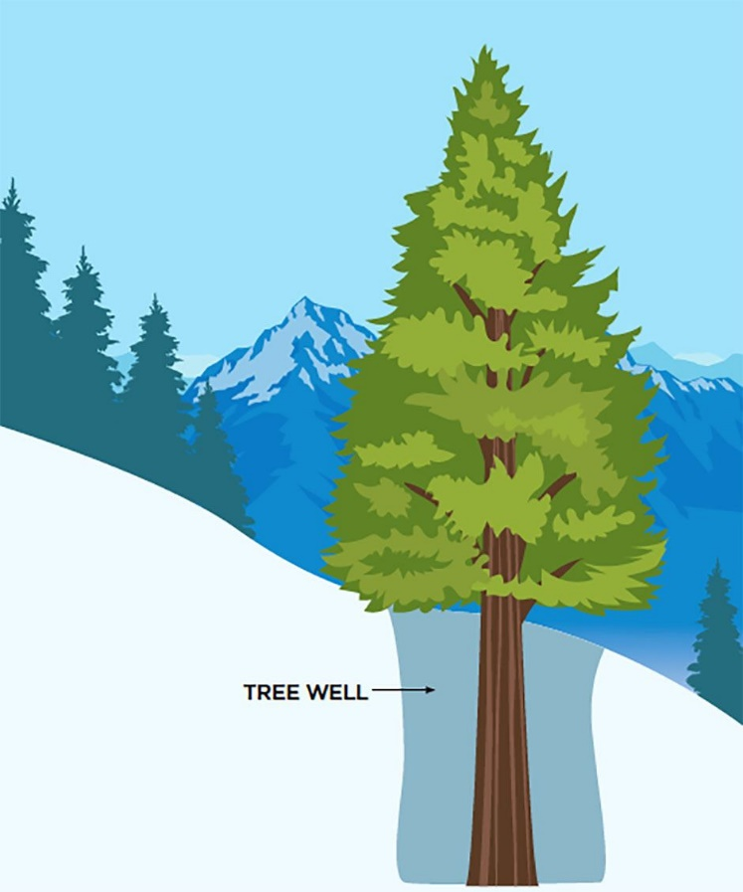
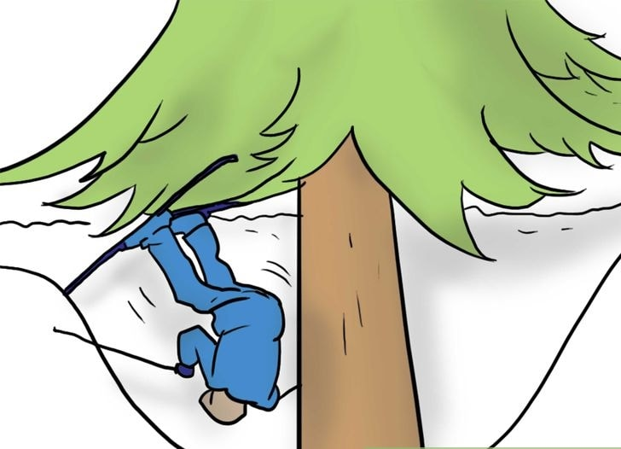
Snow Sport Hazards - Tree Wells
Tree wells are pits of deep, soft snow that form around tree trunks in winter. As winter snow accumulates, low-hanging tree limbs create a protective canopy, preventing snow from compressing next to the trunk.
These low-hanging tree branches often hide tree wells, making them hard to spot. It’s best to assume any tree is a potential hazard.
Because the snow is so soft and deep, a skier, snowboarder, hiker, or snowshoer who falls in headfirst usually cannot free themselves. With skis over their heads, they becoming trapped in the snow.
The situation compounds when dollops of snow collapse off overhead branches or off the tree well walls, further burying the victim. Eventually, people can suffocate in tree wells, a death officially called snow immersion suffocation (SIS).

Slide 11
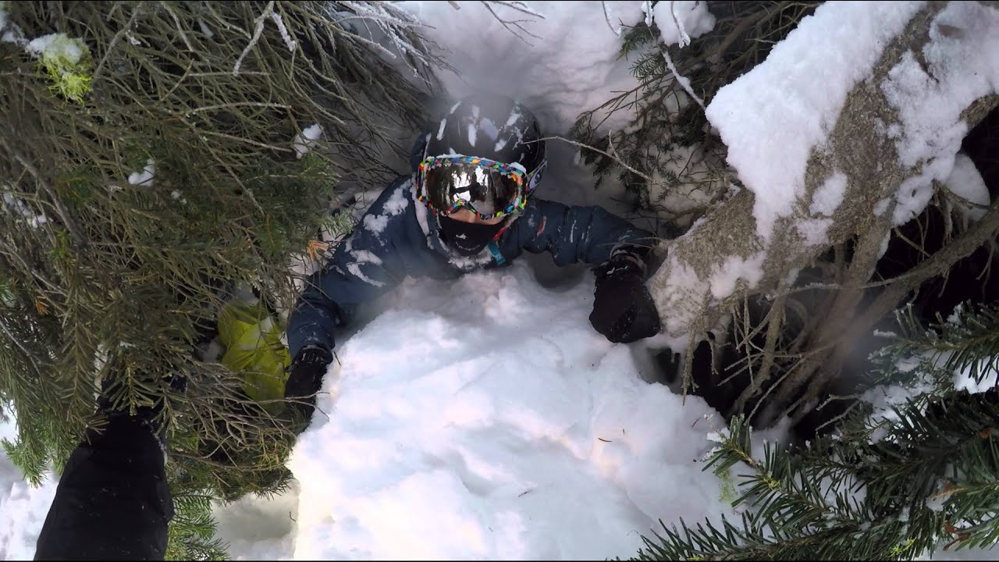
How to Avoid Tree Wells
Avoid skiing in trees. Skiing inbounds on consolidated, groomed runs pretty much guarantees you won’t find tree wells. That said, tree skiing is awesome, and you can do so safely with some of the tips below.
Be cautious after a storm. Most tree well accidents happen after a fresh dump of powder. If you are uncomfortable skiing in powder, stay out of the trees.
Ski defensively. Ski in control when skiing in the trees! If possible, choose a more open forest with room to ski around tree hazards. If it gets tight, slow down.
Don’t ski alone. According to researchers, 90 percent of skiers who fall in a tree well can’t get out by themselves. Ski with a partner and stay in sight of each other. If you lose sight, try to stay in touch audibly, and check in on each other regularly.

Slide 12
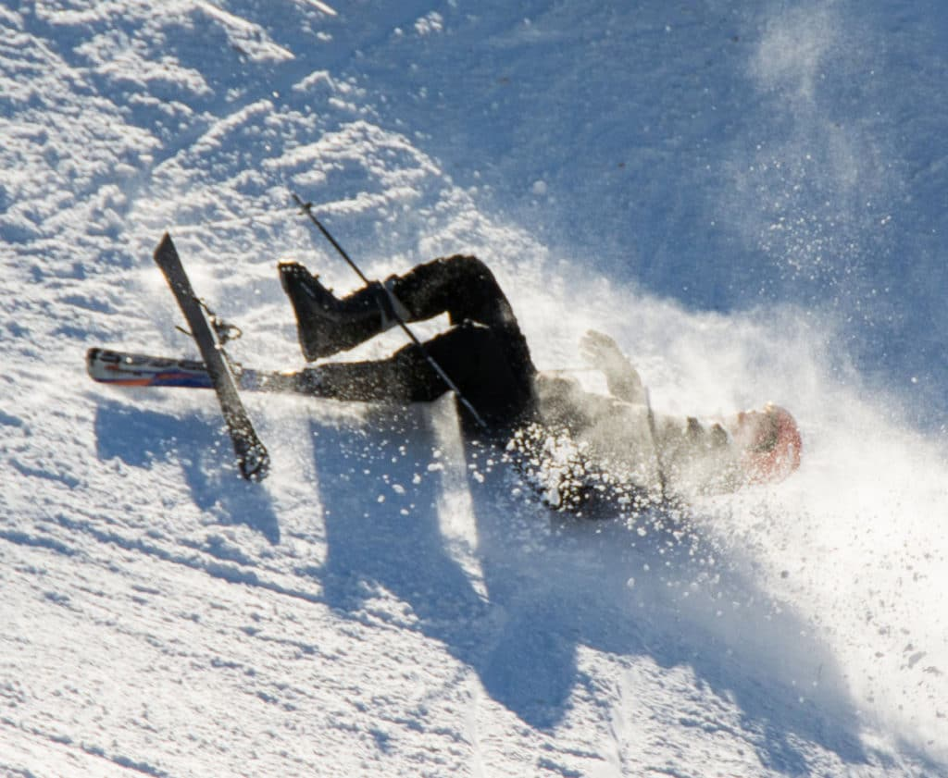
Snow Sport Hazards - Falls and Collisions
Falls and collisions can cause injuries such as concussions, sprains, strains, fractures, and dislocations.
Controlling your speed is critical to staying safe in winter sports like skiing and snowboarding
Know your limits.
  Start out easy and add difficulty levels as your skills progress
Learn proper techniques for falling and getting up safely to minimize the risk of injuries.
Wear appropriate protective gear, such as helmets and padding, and follow the rules and guidelines of the specific snow sport you are participating in.

Slide 13
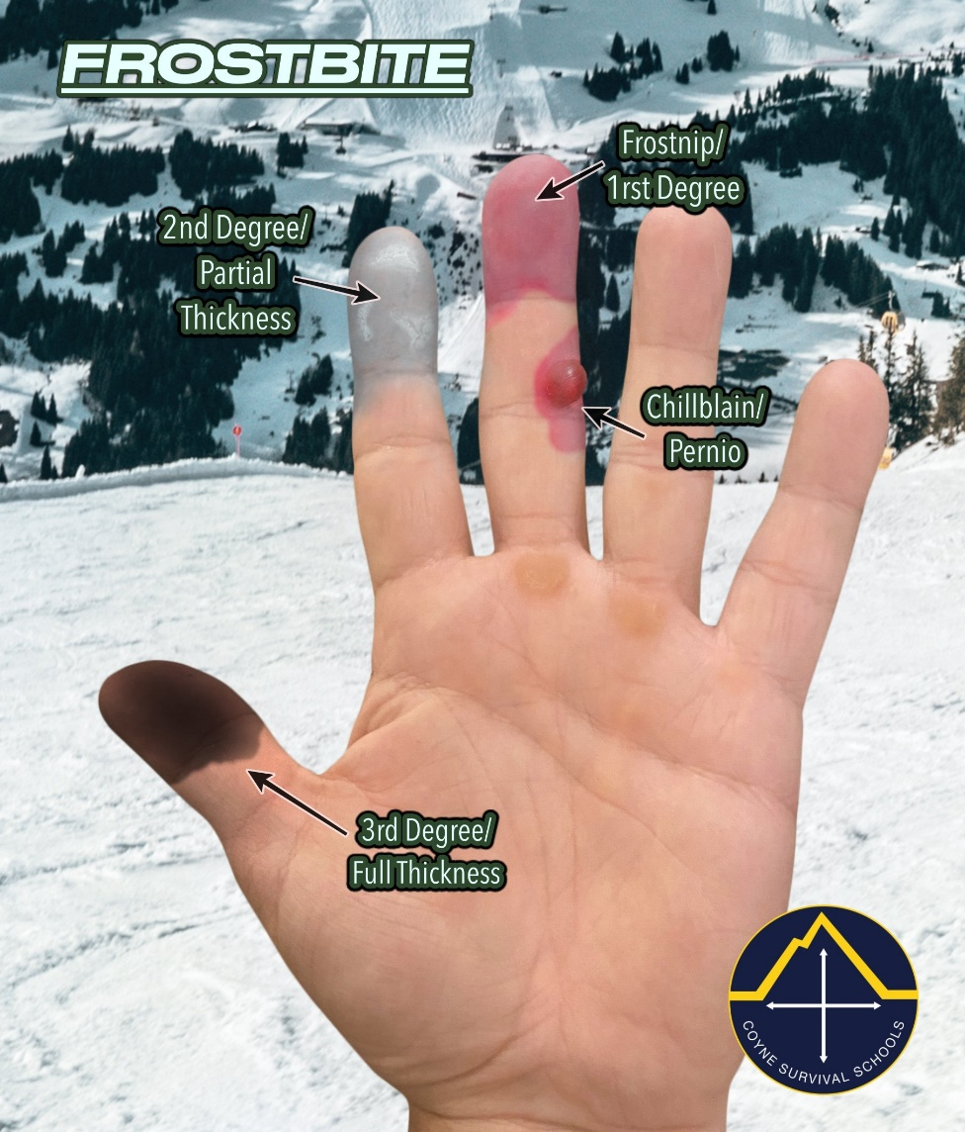
Snow Sport Hazards – Cold Injuries
Cold-related injuries include frostbite, hypothermia, muscle sprains and strains, 'snow blindness' and sunburn.
However, many of the risks can be reduced with planning, adequate preparation and proper equipment.
  Wear appropriate clothing for a snowy environment
    Outer layers – water resistant
    Inner layers – Synthetic and wicking
    Don’t wear cotton
  Snow reflects sunlight and it is easy to become sunburned in a snowy environment.
    Sunscreen should be applied to any exposed skin.
    Eyes can get sun-damaged as well.
      Wear polarized lenses

Slide 14
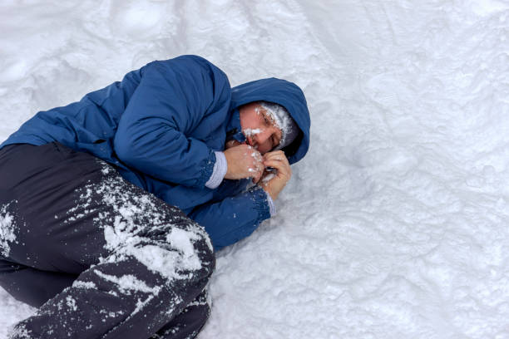
Snow Sport Hazards – Cold Injuries
  Becoming wet increases the risk of hypothermia.
    Recognize the signs of hypothermia and know how to treat it.
    Take regular breaks to warm up.
    Be prepared to change wet/damp clothes or go inside to dry out.
    If your feet get wet, seek shelter as soon as you can. The skin tissues of wet, cold feet are in danger of freezing (frostbite).
Seek shelter and medical attention immediately if you or anyone with you has any of the following symptoms:
  Grey or blue facial skin.
  Cold, hard and white skin.
  Numb patches on the skin.
  Swollen and blistering skin.
  Uncontrollable shivering, followed by lack of shivering.
  Loss of physical coordination.
  Speaking difficulties, such as slurring.
  Loss of control over the small muscles – for example, the muscles of the fingers.
  A strong yearning for sleep.

Slide 15
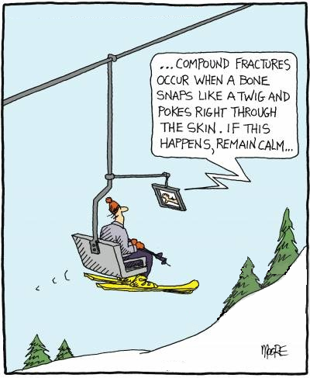
Requirement 1
Do the following:
  Explain to your counselor the hazards you are most likely to encounter while participating in snow sport activities, and what you should do to anticipate, help prevent, mitigate, and respond to these hazards.
  Discuss first aid and prevention for the types of injuries or illnesses that could occur while participating in snow sports, including hypothermia, frostbite, shock, dehydration, sunburn, concussion, fractures, bruises, sprains, and strains. Tell how to apply splints.

Slide 16
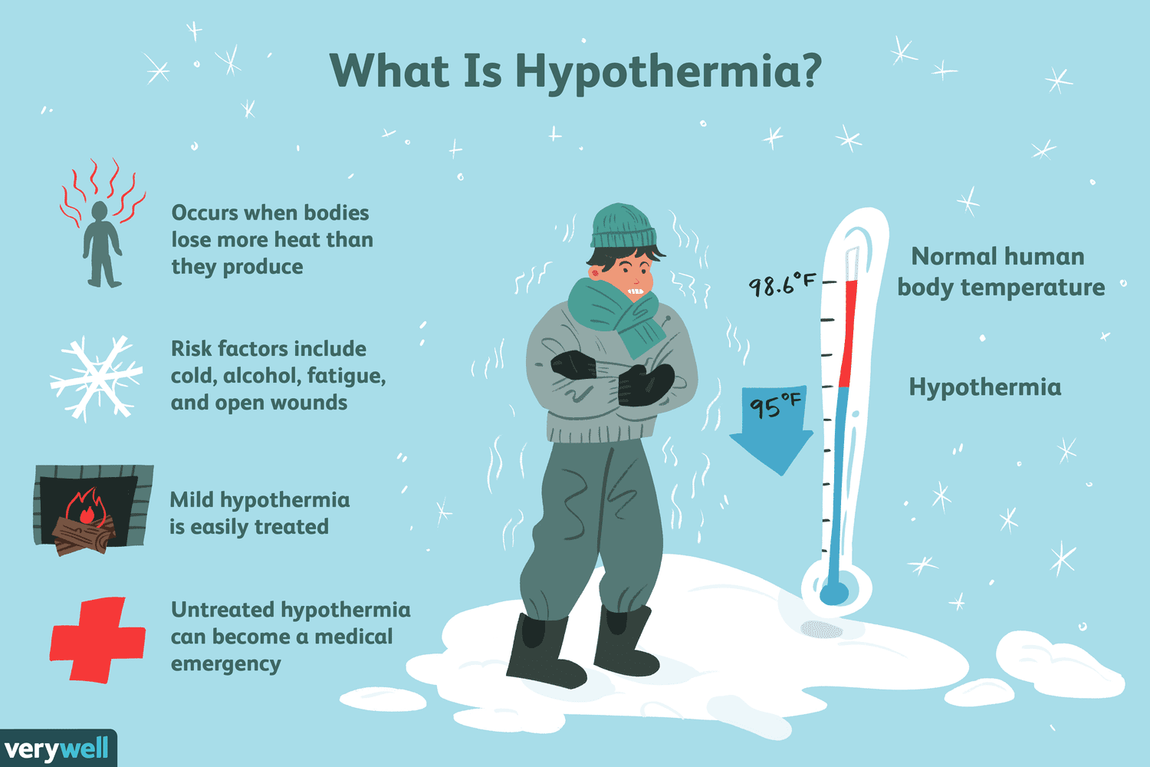

Slide 17
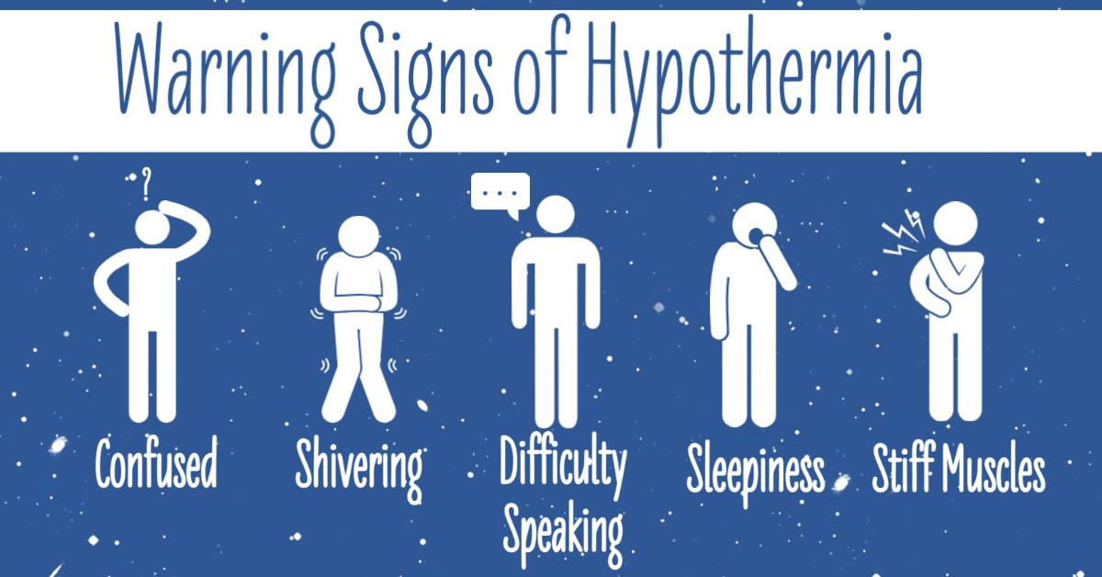
It is important to recognize the warning signs of hypothermia and treat it promptly.

Slide 18
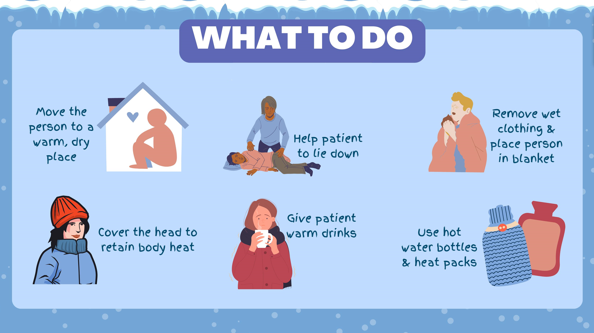

Slide 19
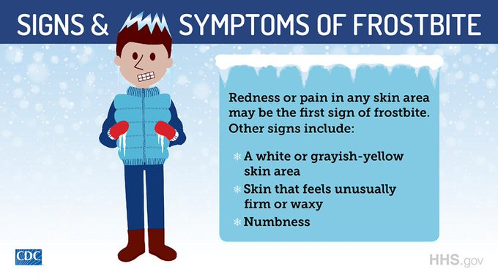
A victim is often unaware of frostbite because frozen tissue is numb.

Slide 20
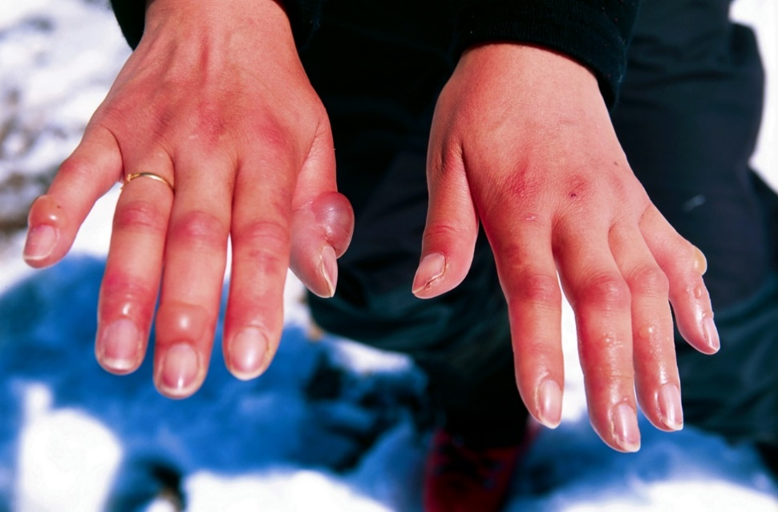
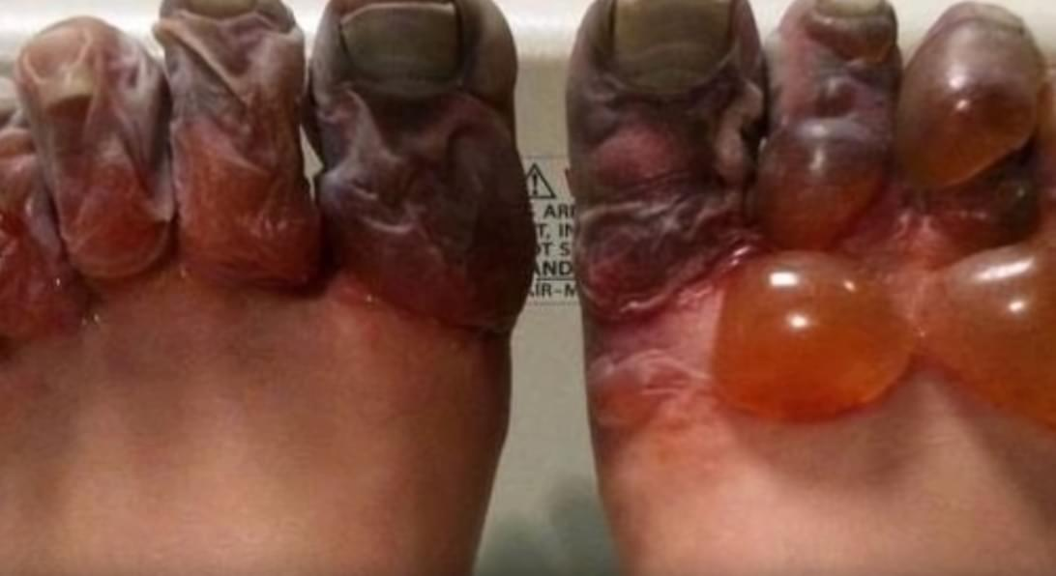
Frostbite Treatment
Gradually warm the affected skin is key to treating frostbite:
Protect your skin from further exposure. If you're outside, warm frostbitten hands by tucking them into your armpits. Protect your face, nose or ears by covering the area with dry, gloved hands. Don't rub the affected area and never rub snow on frostbitten skin.
Get out of the cold. Once you're indoors, remove wet clothes.
Gradually warm frostbitten areas. Put frostbitten hands or feet in warm water — 104 to 107.6 F. Wrap or cover other areas in a warm blanket. Don't use direct heat, such as a stove, heat lamp, fireplace or heating pad, because these can cause burns before you feel them on your numb skin.
Don't walk on frostbitten feet or toes if possible. This further damages the tissue.
If there's any chance the affected areas will freeze again, don't thaw them. If they're already thawed, wrap them up so that they don't become frozen again.
Get emergency medical help. If numbness or sustained pain remains during warming or if blisters develop, seek medical attention.

Slide 21
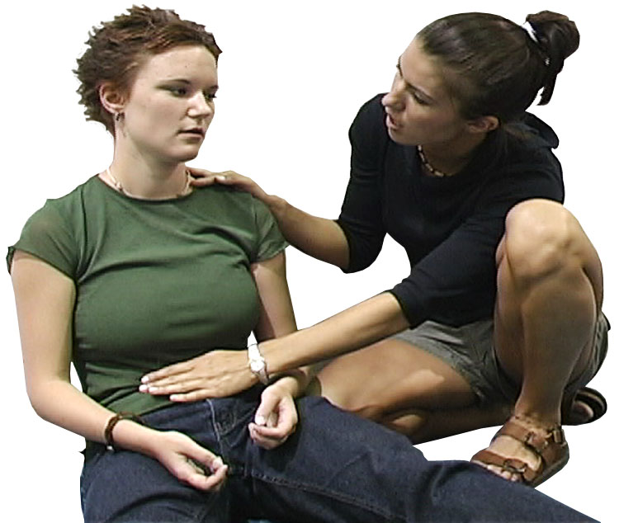
Symptoms of Shock
Shallow and quick breathing.
Excessive sweating.
Low blood pressure.
Experiencing weakness and confusion.
Skin feeling clammy and cold.
Feeling anxious.
Low temperature.
Nausea and/or vomiting.
Passing out.
Rapid pulse.

Slide 22
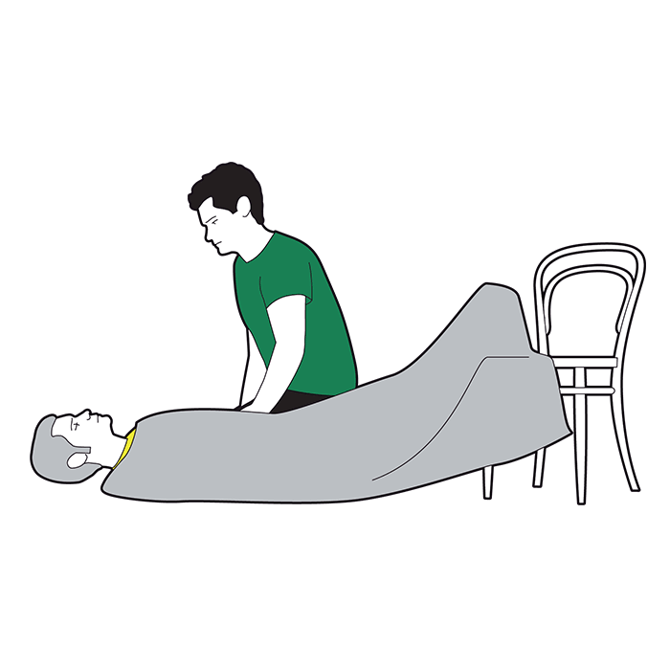
Shock Treatment
Call 911
Lay the Person Down, if Possible
  Elevate the person's feet about 12 inches unless head, neck, or back is injured or you suspect broken hip or leg bones.
  Do not raise the person's head.
  Turn the person on side if they are vomiting or bleeding from the mouth.
Begin CPR, if Necessary
  If the person is not breathing or breathing seems dangerously weak:
  Continue CPR until help arrives or the person wakes up.
Treat Obvious Injuries
Keep Person Warm and Comfortable
  Loosen restrictive clothing.
  Cover with a coat or blanket.
  Keep the person still. Do not move the person unless there is danger.
  Reassure the person.
  Do not give anything to eat or drink.

Slide 23
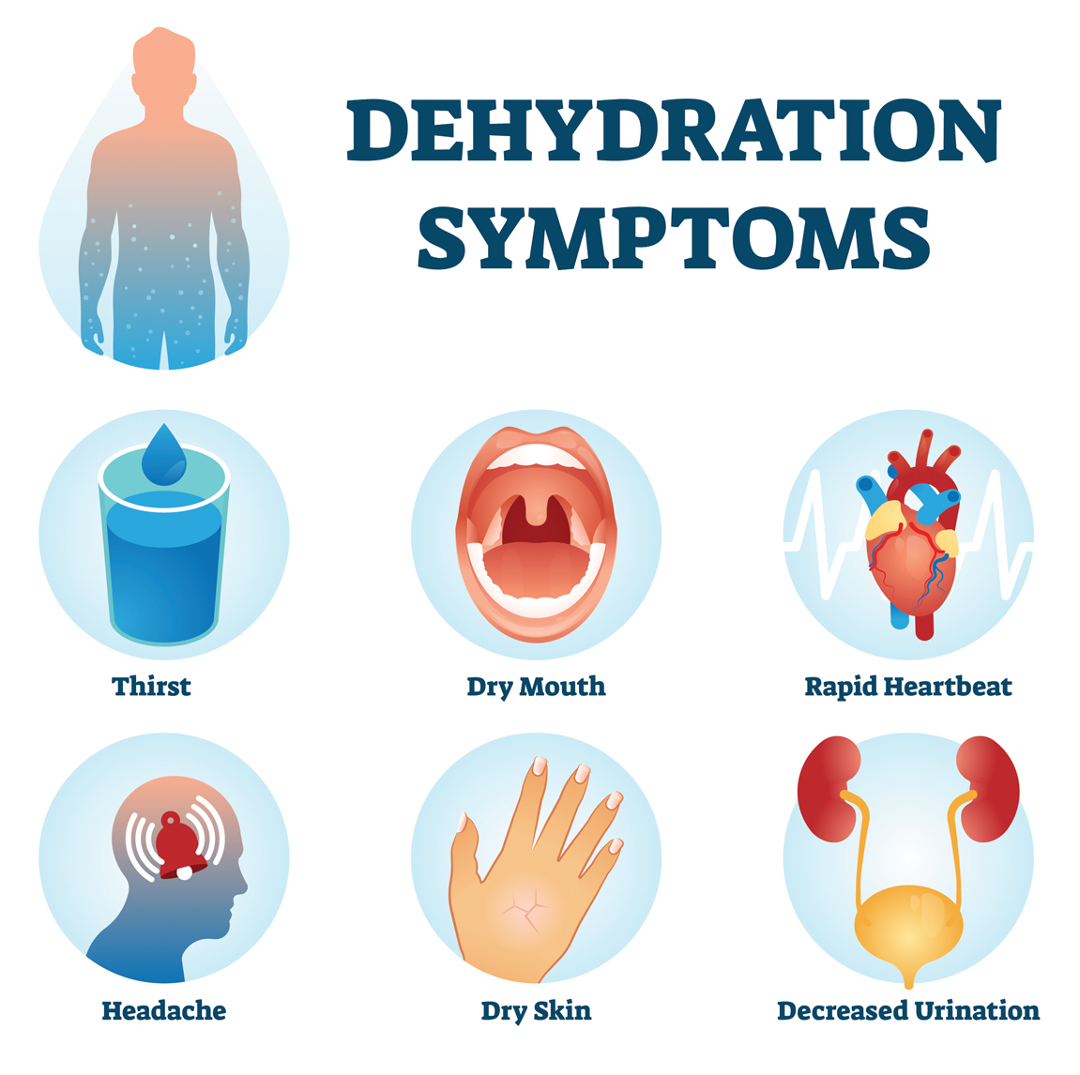

Slide 24
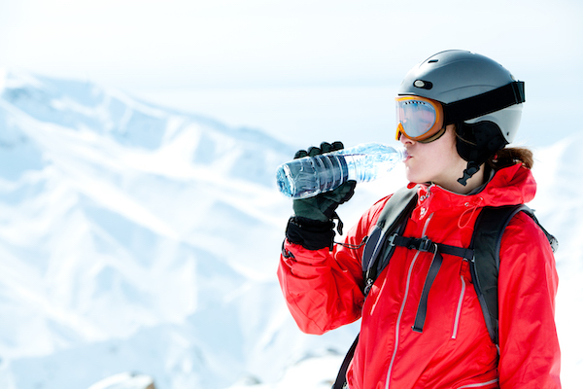
Dehydration Treatment
If you become mildly to moderately dehydrated while working outside or exercising:
  Stop your activity and rest.
  Get out of direct sunlight and lie down in a cool spot, such as in the shade or an air-conditioned area.
  Prop up your feet.
  Take off any extra clothes.
  Drink a rehydration drink, water, juice, or sports drink to replace fluids and minerals.

Slide 25
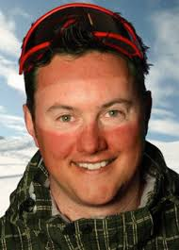
Sunburn
When you get a sunburn, your skin turns red and hurts.
If the burn is severe, you can develop swelling and sunburn blisters.
You may even feel like you have the flu -- feverish, with chills, nausea, headache, and weakness.
Prevention is the key.
  It is important to wear sunblock when in the sun, such as at the beach or when skiing.
  Keep it with you so it can be reapplied throughout the day.

Slide 26
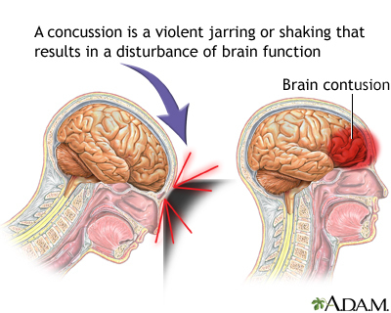
Concussion
Immediately stop the activity.
Monitor the person for changes in symptoms.
  Symptoms can include headaches and trouble with concentration, memory, balance, mood and sleep.
Keep them calm and quiet.
Seek medical evaluation if symptoms persist or worsen.

Slide 27
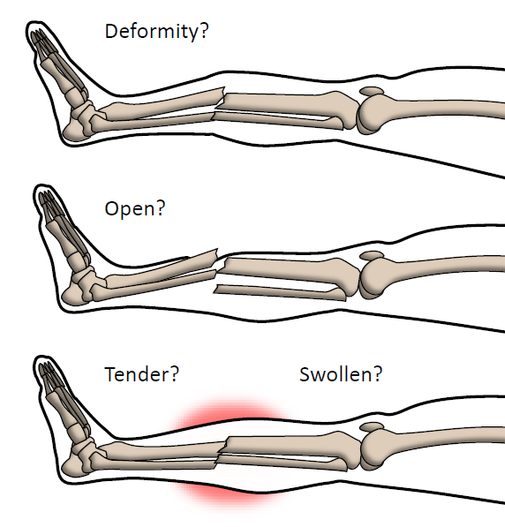
Fractures
Symptoms of fractures:
  Look for DOTS
    D Deformity – abnormal twist of limb
    O Open Wounds
    T Tenderness on applying pressure
    S Swelling/Severe pain

Slide 28
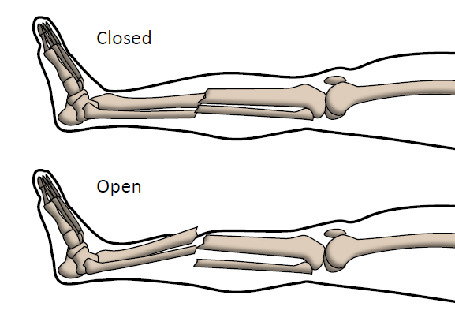
Fractures
Broken Bones (Fractures) – Closed
  This is when the bone is broken but does not cut through the skin
First-Aid
  Call 911
  Treat hurry cases as needed
  Avoid moving the affected extremity

Slide 29
Fractures
Broken Bones (Fractures) – Open
  This is when the bone is broken AND cuts through the skin
  Bone is at high risk of infection
First-Aid
  Call 911
  Treat hurry cases as needed
  Control bleeding by placing sterile gauze around the wound
  Avoid moving the affected extremity

Slide 30
Applying Splints
Broken Bones (Fractures) – Splinting
  It is best to allow medical providers to stabilize and transport someone with a broken bone to the hospital
  If trained medical staff is not available and the victim must be moved, you may need to splint the fracture.
  Goal of splinting is to reduce further damage by reducing movement
Applying a Splint
  Find a rigid straight object that is longer than the bone and joint that you are going to support. You are going to be using this as the splint.
  Cover any broken skin with a sterile cloth. Pad the splint with softer materials such as cloth.
  Tie the splint to the injured limb using tape or rope. Make sure the splint is tight but not so tight that it cuts of blood circulation of the victim. Make sure the splint is applied in a way that prevents the limb from further movement or strain.
  If available, place an ice bag over the splinted break area. Do not place it directly on the skin or wound but cover it with cloth.

Slide 31
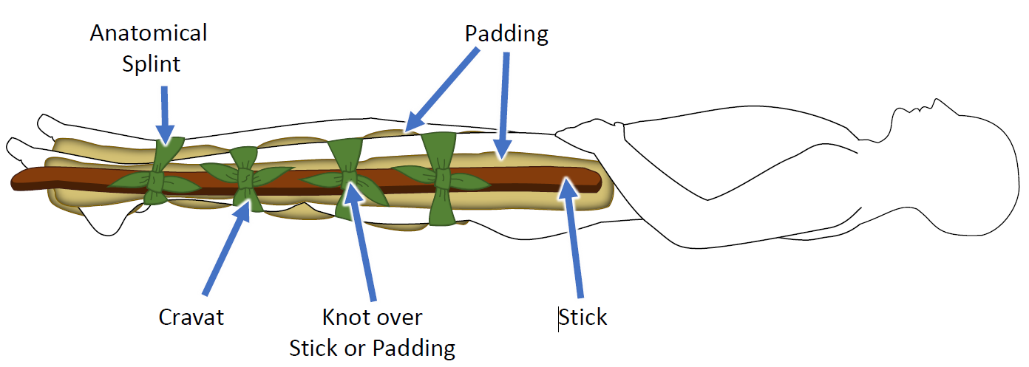
Applying Splints
Fracture Splinting – Upper Leg

Slide 32
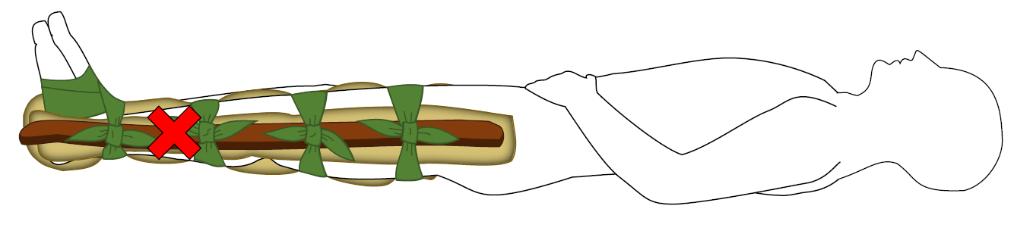
Applying Splints
Fracture Splinting – Lower Leg or Ankle

Slide 33
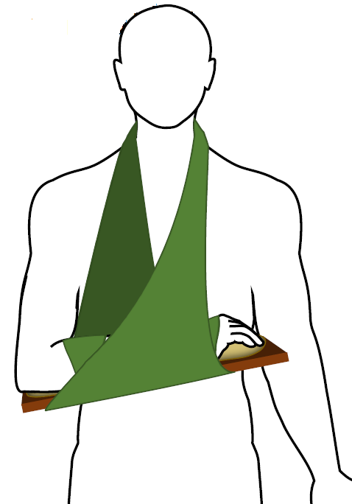
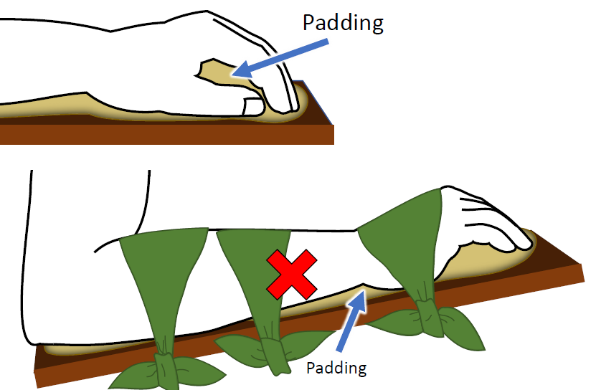
Applying Splints
Fracture Splinting – Forearm or Hand

Slide 34
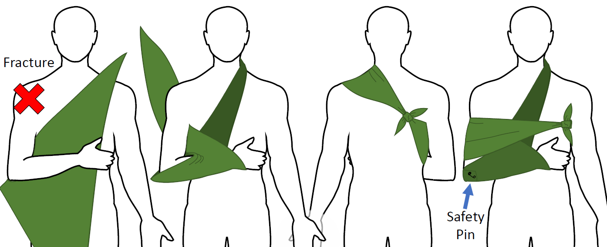
Applying Splints
Immobilizing a Shoulder Injury

Slide 35
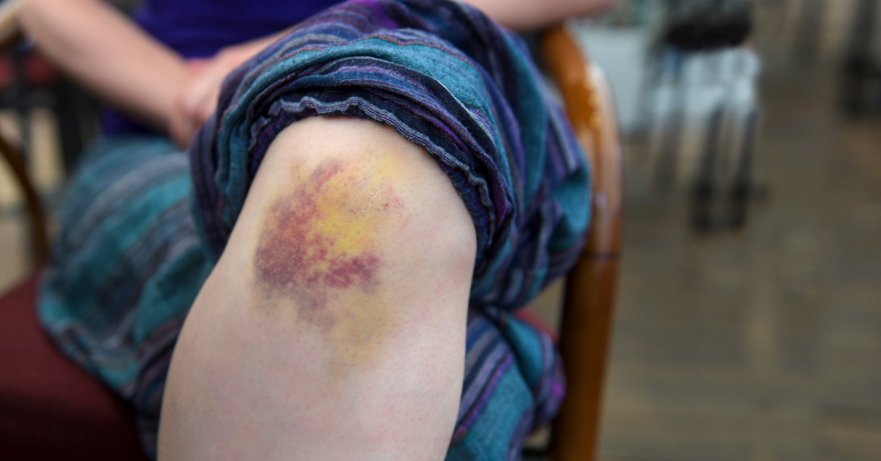
Bruises
Symptoms of a bruise:
  Discoloration of the skin.
  Swelling.
  Tightness in the affected muscle or stiffness in the affected joint.
Treatment for bruising:
  Ice the area on and off for the first 24-48 hours.
  Apply ice for about 15 minutes at a time, and always put something like a towel or wash cloth between the ice and your skin.
  Rest the affected area.
  If possible, elevate the affected area.
  For pain, take acetaminophen (Tylenol). Avoid aspirin or ibuprofen (Advil, Motrin), which

Slide 36
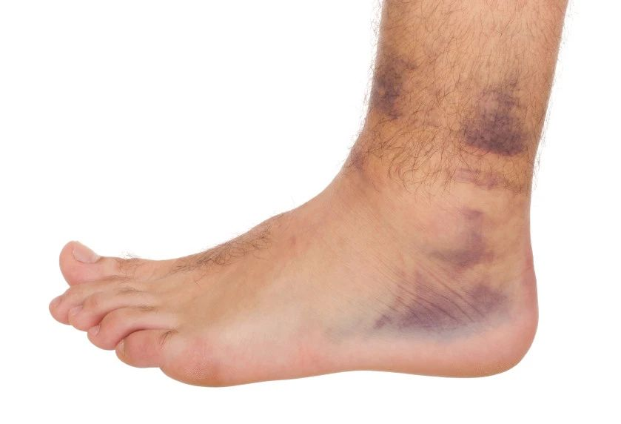
Sprains and Strains
Symptoms:
  Joint pain or muscle pain.
  Swelling.
  Joint stiffness.
  Discoloration of the skin, especially bruising.

Slide 37
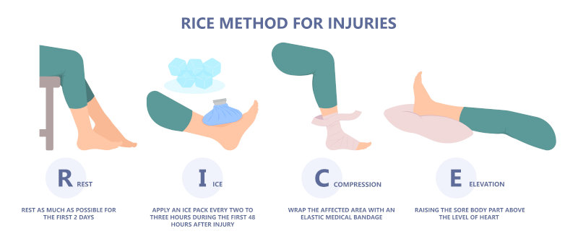
Sprains and Strains
Treatment

Slide 38
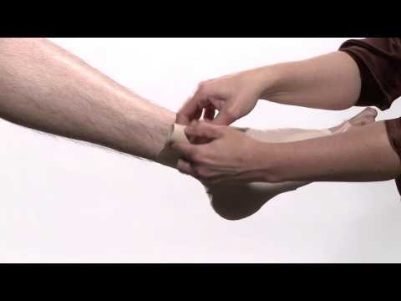
How to Wrap an Ankle
Click on the above video to learn how to wrap an ankle.

Slide 39
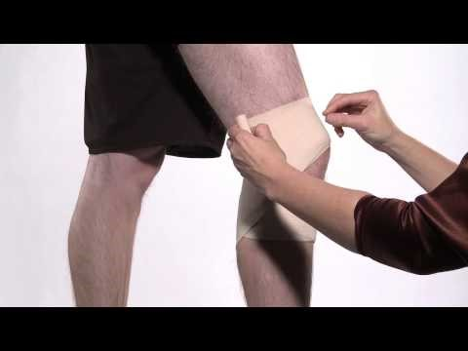
How to Wrap a Knee
Click on the above video to learn how to wrap a knee.

Slide 40
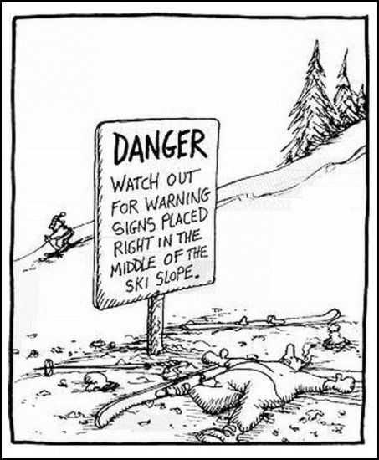
Requirement 2
Do the following:
  Explain why every snow sport participant should be prepared to render first aid in the event of an accident.
  Explain the procedure used to report an accident to the local ski patrol or local emergency personnel.

Slide 41
Be Prepared for Accidents and Injuries
Accidents can happen at any time and in any location on the slopes and there may not be a ski patrol available immediately.
Being prepared to provide first aid ensures that immediate care can be given to the injured person, potentially preventing further complications or worsening of their condition.
The remote and often challenging terrain of snow sports locations can make it difficult for emergency medical services to reach the injured person quickly. By having the knowledge and skills to administer first aid, snow sport participants can provide immediate assistance until professional help arrives.
Providing first aid can help to alleviate pain and discomfort for the injured person, providing them with some comfort and reassurance during a stressful situation.

Slide 42
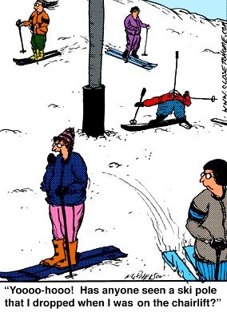
Requirement 2
Do the following:
  Explain why every snow sport participant should be prepared to render first aid in the event of an accident.
  Explain the procedure used to report an accident to the local ski patrol or local emergency personnel.

Slide 43
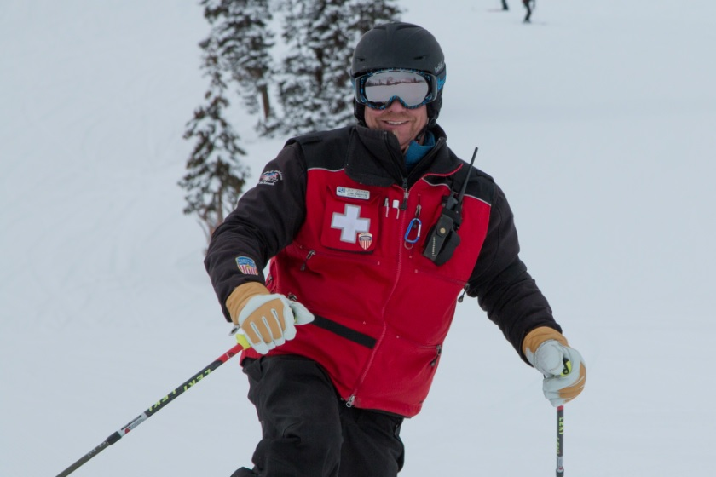
How to Report an Accident to the Ski Patrol
Use a cell phone or ask for help from nearby skiers. Cross ski poles.
Nature of the emergency.
Location of the emergency.
If calling from a phone, phone number where you are calling from.
Remain calm, speak clearly and answer all questions.
After reporting the accident, it is essential to stay with the injured person until help arrives, unless instructed otherwise by the ski patrol or emergency personnel. This ensures that the injured person receives the necessary care and support during the waiting period.

Slide 44
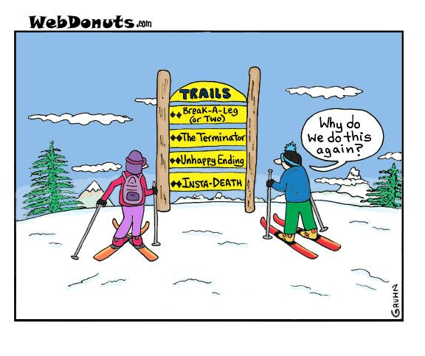
Requirement 3
Explain the international trail-marking system.

Slide 45
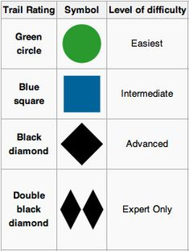
Trail Marking System
Green Circle = easiest
Blue Square = intermediate
Black Diamond = expert
Double Black Diamond = most difficult of all.
The catch is, the difficulty ratings are only meant in comparison to other trails AT THE SAME RESORT. So a blue square in the Midwest could possibly be easier than a green circle in the Rockies.

Slide 46
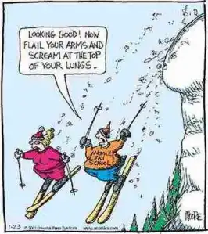
Requirement 4
Discuss the importance of strength, endurance, and flexibility in snow sports. Demonstrate exercises and activities you can do to get fit for the option you choose in requirement 7.

Slide 47
Strength, Endurance, Flexibility
What makes skiing such a great exercise is that is uses all of your muscle groups.
Some muscles are used more than others and those are the ones you want to concentrate on when it comes to your strength workouts.
Most of us hit the slopes and plan on skiing all day, even if it's been months or years since we last skied. Without proper endurance, by afternoon, you're so tired that your legs feel like jello, a prime time for injuries and accidents to happen.
Flexibility is important to avoid injuries when you are skiing. It is important to do some stretching before and after each day of skiing to improve flexibility.

Slide 48
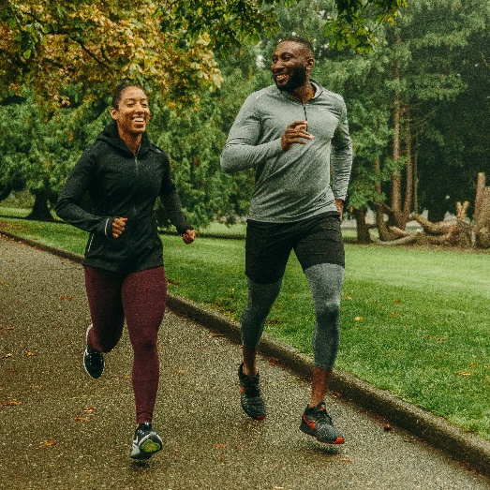
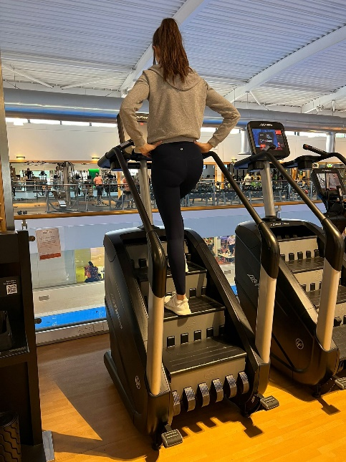
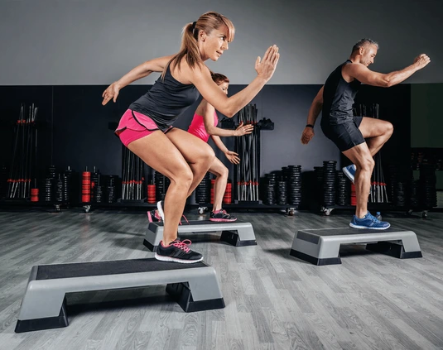
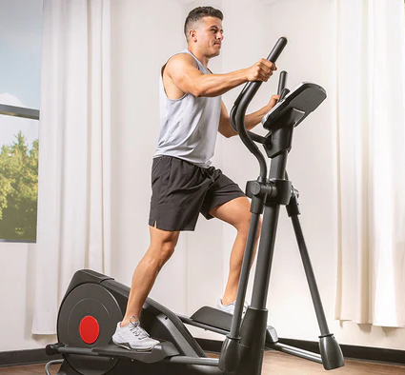
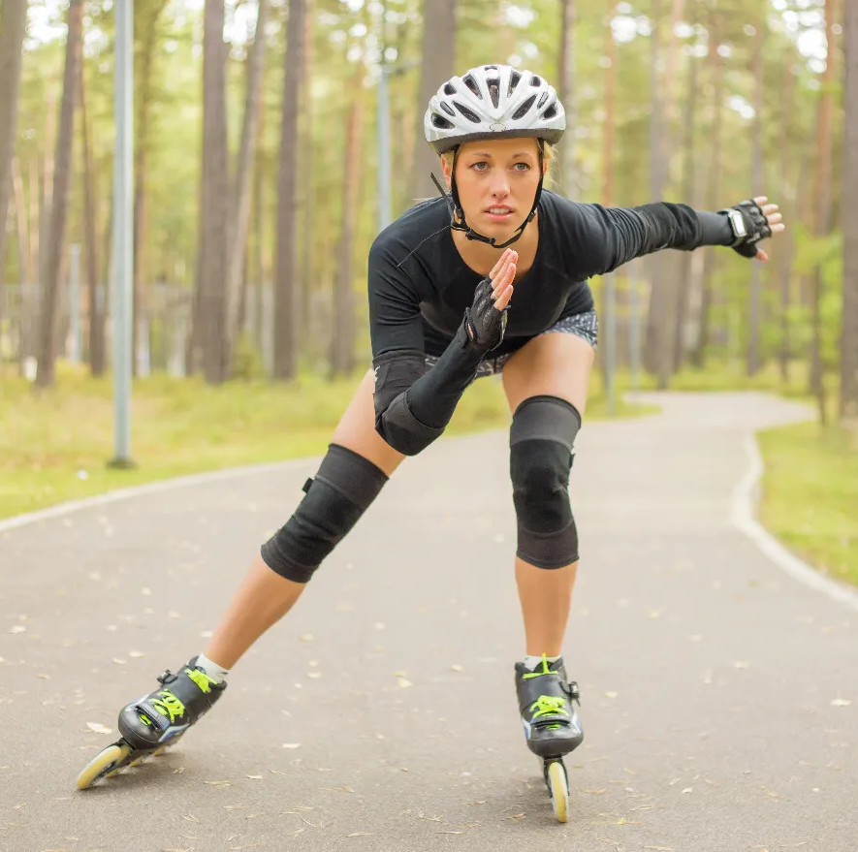
Skiing Exercises
Endurance exercises:
  For skiing include 3 to 5 days each week of your favorite activity such as running, the Stairmaster, step aerobics, elliptical trainer, and/or rollerblading.

Slide 49



Skiing Exercises
Strengthening exercises:
  Probably the most used muscles in skiing are the muscles of the quadriceps, hamstrings, and glutes. These muscles hold you in position as you ski and they also provide protection for your knees. Great exercises for these muscles include squats and lunges.
  Because your knees are bent as you ski, your calves (specifically the soleus) help you stay upright so you don't fall over. A great calf-strengthening exercise is the classic calf raise.
Squats
Lunges
Calf Raises

Slide 50
Stretching and Flexibility
Stretching can help improve flexibility and the range of motion of your joints.
Better flexibility can:
  Improve your performance in physical activities
  Decrease your risk of injuries
  Help your joints move through their full range of motion
  Increase muscle blood flow
  Enable your muscles to work most effectively
  Improve your ability to do daily activities
Before stretching, warm up with light walking, jogging or biking at low intensity for 5 to 10 minutes. Even better, stretch after your workout when your muscles are warm.
Concentrate your stretches on major muscle groups such as your calves, thighs, hips, lower back, neck and shoulders. Make sure that you stretch both sides.
Stretch in a smooth movement, without bouncing. Bouncing as you stretch can injure your muscle and actually contribute to muscle tightness.
Breathe normally and hold each stretch for about 30 seconds; in problem areas, you may need to hold for around 60 seconds.
Expect to feel tension while you're stretching, not pain.
You can achieve the most benefits by stretching regularly, at least two to three times a week.

Slide 51

Stretching for Flexibility

Slide 52

Requirement 5
Present yourself properly clothed and equipped for the option you choose in requirement 7. Discuss how the clothing you have chosen will help keep you warm and protected.

Slide 53

Clothing and Equipment – Snowboarding
Having the proper clothing is essential for having a blast in the snow.
Base Layer: Wear a synthetic layer, long sleeves or short sleeves, both works. This is to keep you dry and when you sweat, it won’t stay in and make you cold, wet
Mid Layer: Wear a fleece jacket. This will preserve body heat and keep you warm.
Outer Layer: Wear a snow jacket and snow pants. This will keep you warm and dry
Head Gear:
  Snowboarders should wear a helmet – protects you from head injuries.
  Ski Mask – protects your face from the cold wind and keep your face dry.
Eye Gear: Ski Goggles or Sunglasses – this is to protect your eyes from the sun reflecting off the snow. Also, it helps keep snow out of your eyes.
Hand Gear: Gloves – to keep your hand from frostbite.
Feet Gear: Ski Socks – to protect your foot from injuries and to keep your feet warm.

Slide 54

Requirement 6
Do EACH of the following:
  Tell the meaning of the Your Responsibility Code for skiers, snow-boarders, and snowshoers. Explain why each rider must follow this code.
  Explain the Smart Style safety program. Tell why it is important and how it applies to participants at snow sport venues in terrain parks and pipes.
  Explain the precautions pertaining to avalanche safety, including the responsibility of individuals regarding avalanche safety.

Slide 55
Responsibility Code
Regardless of how you decide to enjoy the slopes, always show courtesy to others and be aware that there are elements of risk in skiing that common sense and personal awareness can help reduce. Observe the code listed below to ensure safety and enjoyment for everyone on the slopes.
  Always stay in control, and be able to stop or avoid other people or objects.
  People ahead of you have the right of way. It is your responsibility to avoid them.
  You must not stop where you obstruct a trail, or are not visible from above.
  Whenever starting downhill or merging into a trail, look uphill and yield to others.
  Always use devices to help prevent runaway equipment.
  Observe all posted signs and warnings. Keep off closed trails and out of closed areas.
  Prior to using any lift, you must have the knowledge and ability to load, ride and unload safely.
  Know the code. It's your responsibility.

Slide 56

Requirement 6
Do EACH of the following:
  Tell the meaning of the Your Responsibility Code for skiers, snow-boarders, and snowshoers. Explain why each rider must follow this code.
  Explain the Smart Style safety program. Tell why it is important and how it applies to participants at snow sport venues in terrain parks and pipes.
  Explain the precautions pertaining to avalanche safety, including the responsibility of individuals regarding avalanche safety.

Slide 57

Smart Style Safety
There are four main messages that are associated with Smart Style:
Make a Plan Every time you use freestyle terrain, make a plan for each feature you want to use. Your speed, approach and take off will directly affect your maneuver and landing
Look Before You Leap Scope around the jumps first, not over them. Know your landings are clear and clear yourself out of the landing area.
Easy Style It Start small and work your way up. (Inverted aerials not recommended).
Respect Gets Respect From the lift line through the park.

Slide 58

Requirement 6
Do EACH of the following:
  Tell the meaning of the Your Responsibility Code for skiers, snow-boarders, and snowshoers. Explain why each rider must follow this code.
  Explain the Smart Style safety program. Tell why it is important and how it applies to participants at snow sport venues in terrain parks and pipes.
  Explain the precautions pertaining to avalanche safety, including the responsibility of individuals regarding avalanche safety.

Slide 59

Avalanche Safety
Understand where and why avalanches occur: Learning this information will help you avoid avalanches when you recreate in snow-covered mountains.
Check the avalanche forecast: A network of avalanche centers in the U.S. provides daily forecasts with detailed information about conditions to help you prepare for your trip.
Carry rescue gear and know how to use it: It’s best to avoid avalanches in the first place, but if things do go wrong, always have the proper rescue gear and know how to use it.
Learn to recognize five red flags: Once outside, use your observational skills to recognize five key clues warning you about unstable snowpack.
Take a class: At the very least, take an avalanche awareness course. Consider getting more formal training. Get the education that matches your goals and comfort level.

Slide 60
Requirement 7
Complete all of the requirements for Snowboarding
  Discuss forward-fall injuries.
  Show your ability to select the correct equipment for snowboarding and to use it for safety and comfort.
  Show how to use and maintain your own bindings, and explain the use of the different binding methods. Explain the need for leashes.
  Discuss the four types of snowboards. Demonstrate how to carry a snowboard easily and safely.
  Demonstrate how to ride one kind of lift and explain how to ride two others.
  Demonstrate the basic principles of waxing a snowboard.
  Do the following:
    On a gentle slope, demonstrate beginning snowboarding maneuvers. Show basic ways to control speed and direction. Include the side slipping maneuver.
    On slightly steeper terrain, show traversing.
  On a moderate slope, demonstrate an ollie, a nose-end grab, and a wheelie.
  Make a controlled run down an intermediate slope.
  Demonstrate your ability to ride in varied conditions, including changes in pitch, snow conditions, and moguls. Maintain your balance and ability to turn.
  Name the major snowboarding organizations in the United States and explain their functions.

Slide 61

Forward Fall Injuries
Forward-fall injuries are one of the most common types of injuries in snowboarding.
When a rider falls forward, there is a risk of wrist, elbow, and shoulder injuries from twisting or impact.
When you feel yourself losing balance, try to relax and roll with the fall rather than resisting it.
  Bend knees and get low
  If falling forward, land on knees keeping your arms in front of you.
  Try to avoid using your hands to break the fall as this magnifies the force applied to wrist, elbows and shoulder.
  If you fall backwards, land on butt
Wearing wrist guards can also provide added protection and support for your wrists.

Slide 62
Requirement 7
Complete all of the requirements for Snowboarding
  Discuss forward-fall injuries.
  Show your ability to select the correct equipment for snowboarding and to use it for safety and comfort.
  Show how to use and maintain your own bindings, and explain the use of the different binding methods. Explain the need for leashes.
  Discuss the four types of snowboards. Demonstrate how to carry a snowboard easily and safely.
  Demonstrate how to ride one kind of lift and explain how to ride two others.
  Demonstrate the basic principles of waxing a snowboard.
  Do the following:
    On a gentle slope, demonstrate beginning snowboarding maneuvers. Show basic ways to control speed and direction. Include the side slipping maneuver.
    On slightly steeper terrain, show traversing.
  On a moderate slope, demonstrate an ollie, a nose-end grab, and a wheelie.
  Make a controlled run down an intermediate slope.
  Demonstrate your ability to ride in varied conditions, including changes in pitch, snow conditions, and moguls. Maintain your balance and ability to turn.
  Name the major snowboarding organizations in the United States and explain their functions.

Slide 63

How to Choose a Snowboard
  Snowboard length:
    As a general rule, if you stand a board on its tail, the nose of the board should reach somewhere between your nose and chin.
    It’s more precise to use your height and body weight, which is what many snowboard manufacturers now recommend.
    The size chart at the right can be used to give you a good idea of the right board length based on your height and weight.

Slide 64

Snowboard Width and Boot Size
When it comes to compatibility with your snowboard, the size of your boot is important to take into consideration.
People with larger (11.5+) and smaller (<7) boot sizes should purchase wider and narrower boards, respectively.
Boot Size (US Men’s) | <8 | 8 - 10 | 10 - 11.5 | 11.5+
Width (mm) | <245 | 246 - 254 | 255 - 259 | 260+
Snowboard Width | Narrow | Regular | Mid-Wide | Wide

Slide 65


Snowboard Boot Fit
How Should Snowboard Boots Fit?
  Snowboard boots should fit snugly, but not to the point where they cause pain.
  Most boots need several days of riding for them to conform to their true size, and as a result should be fairly tight when brand new.
  In a good fitting boot your toes will gently graze the boot’s toecap and you should be able to wiggle your toes inside the boots.
  When your knee is driven forward your heel should remain in place as this is important for board control.

Slide 66

Snowboard Boot Flex
Snowboard Boot Flex
Snowboard boots have different flex ratings, ranging from soft to stiff.
Boot flex is a personal preference but generally a softer flex is chosen by park and beginner riders.
For advanced, all mountain riders and freeriders, a stiffer flexing boot is often favored.
Riding Type | Boot Flex
All-mountain (most riders) | Soft to medium
All-mountain (racers) | Stiff
Freeride | Stiff
Freestyle | Soft

Slide 67

Snowboard Boot Lacing System
Traditional Laces
  Easy to use, traditional laces are very customizable but often loosen during the day.
  Despite this, many snowboarders stick with this classic system for easy lace replacement and a tailor-made fit.
Quick-pull Laces
  Faster than traditional lacing systems.
  Many quick-pull lacing systems allow the forefoot and ankle/lower leg to tighten independently from each other, this is called zonal lacing.
  This type of lacing system is fast, easy, and can be tightened while wearing gloves.
Boa System
  Boa lacing systems offer fast and easy micro adjustability to your boot fit.
  Boa systems use a ratcheting dial attached to a cable.
  The turning and locking can be done with one hand and also with gloves on.

Slide 68
Requirement 7
Complete all of the requirements for Snowboarding
  Discuss forward-fall injuries.
  Show your ability to select the correct equipment for snowboarding and to use it for safety and comfort.
  Show how to use and maintain your own bindings, and explain the use of the different binding methods. Explain the need for leashes.
  Discuss the four types of snowboards. Demonstrate how to carry a snowboard easily and safely.
  Demonstrate how to ride one kind of lift and explain how to ride two others.
  Demonstrate the basic principles of waxing a snowboard.
  Do the following:
    On a gentle slope, demonstrate beginning snowboarding maneuvers. Show basic ways to control speed and direction. Include the side slipping maneuver.
    On slightly steeper terrain, show traversing.
  On a moderate slope, demonstrate an ollie, a nose-end grab, and a wheelie.
  Make a controlled run down an intermediate slope.
  Demonstrate your ability to ride in varied conditions, including changes in pitch, snow conditions, and moguls. Maintain your balance and ability to turn.
  Name the major snowboarding organizations in the United States and explain their functions.

Slide 69

Snowboard Bindings
Strap in Bindings
Strap snowboard bindings are the most common type of snowboard binding.
  These typically feature two straps, an ankle strap and a toe strap.
  The ankle strap spans across the top of the boot to secure the foot into the heel cup area of the binding against the highback.
  The toe cap strap ratchets across the toe of the boot, ensuring the toes and ball of the foot are securely fit into the binding, preventing any unwanted forward or lateral movement.
Strap-in bindings come in a variety of support, cushioning and price options, making them a great option for all ride types and skill levels.

Slide 70


Snowboard Bindings
Rear-Entry Bindings
  Rear entry bindings can be identified by the reinforced highback and single strap at the toe.
  The highback of these bindings will pop open, you slide your foot into the strap and then close the highback onto your boot.

Slide 71

Snowboard Bindings
Step-On Bindings
  Step-in bindings use a locking mechanism (like toe and heel cleats) to connect your boots to the board so you can click in and ride.
  These bindings are designed to save time, energy and strap-induced frustration on the slopes.

Slide 72

Maintaining Snowboard Bindings
Maintaining Your Bindings
  Check for damage before use.
    Look for cracks, tears, and breaks.
    If you see a problem, have it repaired.
  Check screws for tightness.
  Check to see if straps function smoothly and properly.
  If you have rear entry or step-on bindings, check to see that they move freely.
  Keep your bindings clean.
    Remove dirt, debris, and salt (from roads).

Slide 73

Snowboard Leash
Most leashes are designed to attach to your snowboard binding at one end and either your snowboard boot or around your ankle at the other end.
Snowboard leashes are designed with safety in mind, and prevents the board from sliding away from you and possibly hitting and injuring someone else.

Slide 74
Requirement 7
Complete all of the requirements for Snowboarding
  Discuss forward-fall injuries.
  Show your ability to select the correct equipment for snowboarding and to use it for safety and comfort.
  Show how to use and maintain your own bindings, and explain the use of the different binding methods. Explain the need for leashes.
  Discuss the four types of snowboards. Demonstrate how to carry a snowboard easily and safely.
  Demonstrate how to ride one kind of lift and explain how to ride two others.
  Demonstrate the basic principles of waxing a snowboard.
  Do the following:
    On a gentle slope, demonstrate beginning snowboarding maneuvers. Show basic ways to control speed and direction. Include the side slipping maneuver.
    On slightly steeper terrain, show traversing.
  On a moderate slope, demonstrate an ollie, a nose-end grab, and a wheelie.
  Make a controlled run down an intermediate slope.
  Demonstrate your ability to ride in varied conditions, including changes in pitch, snow conditions, and moguls. Maintain your balance and ability to turn.
  Name the major snowboarding organizations in the United States and explain their functions.

Slide 75

Types of Snowboards
All-mountain boards are versatile and suitable for various terrains and riding styles. They are a good choice for beginners and intermediate riders.
Freestyle boards are designed for tricks and jumps in terrain parks. They are shorter and more maneuverable, with a twin-tip shape that allows for riding in both directions.
Freeride boards are designed for off-trail riding and backcountry exploration. They are longer and stiffer, providing stability and control in challenging conditions.
Powder boards are specifically designed for deep snow and feature a wider nose and a tapered shape for better floatation.
Splitboards are best for the backcountry. These backcountry-specific boards split in half to create two skis and permit climbing on untracked backcountry slopes. You later reconnect the halves and ride downhill.

Slide 76

How to Carry a Snowboard
Carrying it by hand
  Carry it under your arm so that the bindings are on the outside.
  Hold the middle of the snowboard.
  Take care to make sure you don't bump it into people or things.
Avoid!
  Dragging your board along the ground, especially if there are rocks or no snow.
  You will damage the edges and the base of your snowboard

Slide 77
Requirement 7
Complete all of the requirements for Snowboarding
  Discuss forward-fall injuries.
  Show your ability to select the correct equipment for snowboarding and to use it for safety and comfort.
  Show how to use and maintain your own bindings, and explain the use of the different binding methods. Explain the need for leashes.
  Discuss the four types of snowboards. Demonstrate how to carry a snowboard easily and safely.
  Demonstrate how to ride one kind of lift and explain how to ride two others.
  Demonstrate the basic principles of waxing a snowboard.
  Do the following:
    On a gentle slope, demonstrate beginning snowboarding maneuvers. Show basic ways to control speed and direction. Include the side slipping maneuver.
    On slightly steeper terrain, show traversing.
  On a moderate slope, demonstrate an ollie, a nose-end grab, and a wheelie.
  Make a controlled run down an intermediate slope.
  Demonstrate your ability to ride in varied conditions, including changes in pitch, snow conditions, and moguls. Maintain your balance and ability to turn.
  Name the major snowboarding organizations in the United States and explain their functions.

Slide 78

How to Ride a Chairlift
Click on the above video to learn how to get on and off of a chair lift.

Slide 79

Using a T-Bar or J-Bar
Click on the above video to learn how to use a T-Bar.

Slide 80

Using a Rope Tow
Click on the above video to learn how to use a rope tow.

Slide 81

Using a Magic Carpet
Click on the above video to learn how to use a magic carpet.

Slide 82
Requirement 7
Complete all of the requirements for Snowboarding
  Discuss forward-fall injuries.
  Show your ability to select the correct equipment for snowboarding and to use it for safety and comfort.
  Show how to use and maintain your own bindings, and explain the use of the different binding methods. Explain the need for leashes.
  Discuss the four types of snowboards. Demonstrate how to carry a snowboard easily and safely.
  Demonstrate how to ride one kind of lift and explain how to ride two others.
  Demonstrate the basic principles of waxing a snowboard.
  Do the following:
    On a gentle slope, demonstrate beginning snowboarding maneuvers. Show basic ways to control speed and direction. Include the side slipping maneuver.
    On slightly steeper terrain, show traversing.
  On a moderate slope, demonstrate an ollie, a nose-end grab, and a wheelie.
  Make a controlled run down an intermediate slope.
  Demonstrate your ability to ride in varied conditions, including changes in pitch, snow conditions, and moguls. Maintain your balance and ability to turn.
  Name the major snowboarding organizations in the United States and explain their functions.

Slide 83

Waxing a Snowboard
Click on the above video to learn how to wax a snowboard.

Slide 84
Requirement 7
Complete all of the requirements for Snowboarding
  Discuss forward-fall injuries.
  Show your ability to select the correct equipment for snowboarding and to use it for safety and comfort.
  Show how to use and maintain your own bindings, and explain the use of the different binding methods. Explain the need for leashes.
  Discuss the four types of snowboards. Demonstrate how to carry a snowboard easily and safely.
  Demonstrate how to ride one kind of lift and explain how to ride two others.
  Demonstrate the basic principles of waxing a snowboard.
  Do the following:
    On a gentle slope, demonstrate beginning snowboarding maneuvers. Show basic ways to control speed and direction. Include the side slipping maneuver.
    On slightly steeper terrain, show traversing.
  On a moderate slope, demonstrate an ollie, a nose-end grab, and a wheelie.
  Make a controlled run down an intermediate slope.
  Demonstrate your ability to ride in varied conditions, including changes in pitch, snow conditions, and moguls. Maintain your balance and ability to turn.
  Name the major snowboarding organizations in the United States and explain their functions.

Slide 85

How to Put On a Snowboard
Click on the above video to learn how to put on a snowboard.

Slide 86

The Basics of Snowboarding
Click on the above video to learn the basics of snowboarding.

Slide 87
Requirement 7
Complete all of the requirements for Snowboarding
  Discuss forward-fall injuries.
  Show your ability to select the correct equipment for snowboarding and to use it for safety and comfort.
  Show how to use and maintain your own bindings, and explain the use of the different binding methods. Explain the need for leashes.
  Discuss the four types of snowboards. Demonstrate how to carry a snowboard easily and safely.
  Demonstrate how to ride one kind of lift and explain how to ride two others.
  Demonstrate the basic principles of waxing a snowboard.
  Do the following:
    On a gentle slope, demonstrate beginning snowboarding maneuvers. Show basic ways to control speed and direction. Include the side slipping maneuver.
    On slightly steeper terrain, show traversing.
  On a moderate slope, demonstrate an ollie, a nose-end grab, and a wheelie.
  Make a controlled run down an intermediate slope.
  Demonstrate your ability to ride in varied conditions, including changes in pitch, snow conditions, and moguls. Maintain your balance and ability to turn.
  Name the major snowboarding organizations in the United States and explain their functions.

Slide 88

Demonstrate an Ollie
Click on the above video to learn how to do an Ollie.

Slide 89

Demonstrate a Nose Grab
Click on the above video to learn how to do a Nose Grab.

Slide 90

Demonstrate a Wheelie (Tail Press)
Click on the above video to learn how to do a Tail Press.

Slide 91
Requirement 7
Complete all of the requirements for Snowboarding
  Discuss forward-fall injuries.
  Show your ability to select the correct equipment for snowboarding and to use it for safety and comfort.
  Show how to use and maintain your own bindings, and explain the use of the different binding methods. Explain the need for leashes.
  Discuss the four types of snowboards. Demonstrate how to carry a snowboard easily and safely.
  Demonstrate how to ride one kind of lift and explain how to ride two others.
  Demonstrate the basic principles of waxing a snowboard.
  Do the following:
    On a gentle slope, demonstrate beginning snowboarding maneuvers. Show basic ways to control speed and direction. Include the side slipping maneuver.
    On slightly steeper terrain, show traversing.
  On a moderate slope, demonstrate an ollie, a nose-end grab, and a wheelie.
  Make a controlled run down an intermediate slope.
  Demonstrate your ability to ride in varied conditions, including changes in pitch, snow conditions, and moguls. Maintain your balance and ability to turn.
  Name the major snowboarding organizations in the United States and explain their functions.

Slide 92

Demonstrate Your Ability on the Slope
  Make a controlled run down an intermediate slope.
  Demonstrate your ability to ride in varied conditions, including changes in pitch, snow conditions, and moguls. Maintain your balance and ability to turn.

Slide 93
Requirement 7
Complete all of the requirements for Snowboarding
  Discuss forward-fall injuries.
  Show your ability to select the correct equipment for snowboarding and to use it for safety and comfort.
  Show how to use and maintain your own bindings, and explain the use of the different binding methods. Explain the need for leashes.
  Discuss the four types of snowboards. Demonstrate how to carry a snowboard easily and safely.
  Demonstrate how to ride one kind of lift and explain how to ride two others.
  Demonstrate the basic principles of waxing a snowboard.
  Do the following:
    On a gentle slope, demonstrate beginning snowboarding maneuvers. Show basic ways to control speed and direction. Include the side slipping maneuver.
    On slightly steeper terrain, show traversing.
  On a moderate slope, demonstrate an ollie, a nose-end grab, and a wheelie.
  Make a controlled run down an intermediate slope.
  Demonstrate your ability to ride in varied conditions, including changes in pitch, snow conditions, and moguls. Maintain your balance and ability to turn.
  Name the major snowboarding organizations in the United States and explain their functions.

Slide 94

Snowboarding Organizations in the U.S.
PSIA-AASI (Professional Ski Instructors of America and American Association of Snowboard Instructors)
The Professional Ski Instructors of America and the American Association of Snowboard Instructors (PSIA-AASI) is the world’s largest organization dedicated to teaching people how to ski and snowboard.
Establishes certification standards for instructors and develops education materials to help members reach their certification goals.

Slide 95

Snowboarding Organizations in the U.S.
United States of America Snowboard and Freeski Association
Promotes growth and development of amateur snowboarding through competition.
Hundreds of events nationwide
The USASA is the first step in the Olympic pipeline for snowboarding and freeskiing.

Slide 96

Snowboarding Organizations in the U.S.
United States Ski and Snowboard Association
United States Ski Association is the national governing body overseeing the sports of Olympic skiing and snowboarding in the United States.
It is engaged in membership, competition, training, development, and education for world-class skiers and snowboarders who are, or aspire to become, members of the United States ski and snowboard teams.

Slide 97

The End

